Slide 1
Rural Development Initiatives and Internal Controls through IT
Presentation by
Dr. Ajay S. Singh ICAS,
Chief Controller of Accounts
MoRD, MoPR, MoDWS and DoLR

Slide 2
Year-wise Expenditure (GOI) in
Rural Development programs (Rs. in crore)
*BE for the year 2019-20

Slide 3
Centrally Sponsored Schemes
2019-20
(Rs. in Crore)
S.No | Scheme Name | B.E
1 | Mahatma Gandhi National Rural Employment Scheme | 60,000
2 | Rural Housing | 19,000
3 | Pradhan Mantri Gram Sadak Yojana | 19,000
4 | Natinal Social Assistance Programme | 9,200
5 | Aajeevika-National Rural Livelihood Mission | 9,024
6 | Rurban Mission | 800
 | Total | 1,17,024

Slide 4
Public Financial Management System (PFMS) for Better Financial Management
PFMS includes:
Budgeting and Budgetary Controls
Financial Appraisal
Financial Concurrence
Payment- Establishment, CS, CSS & Transfers
Receipt- Tax and Non Tax
Accounting and MIS
Internal Audit

Slide 5
PFMS: Transaction Perspective
(Real time Transaction System)
PFMS Transaction System
UIDAI
Citizen
Banks
Post Offices
PD
(Sanction)
DDO- Bill Preparation
PAO - Payments
MIS Users for Analytical Approach
State Govt. (Depts/
Treasury..)
Imp. Agency
(E-Pmnt & other trans)
External Sys (NregaSoft/AwasSoft/MCTS..)
PFMS is a Centralized Transaction System & Platform, providing end to end Financial management services to all stakeholders.

Slide 6
Account Validation Response
Daily Transaction Data
PFMS–CBS INTEGRATION
PFMS-CBS Interface
PFMS Application
Account Validation / Transaction by User
Cycle Period
Near Real Time
Bank CBS System
Bank Integration of PFMS with Core Banking Solution (CBS) facilitates, near real time bank account validation, fund transfer and access to view bank balances of implementing agencies.
The system is configured to make e-payment using Digital Signature, Corporate Internet Banking (CINB) and Payment Print Advice.

Slide 7
Internal Audit in Rural Development
Proposal for setting up Internal Audit Wing approved. Proposal for creation of posts for Internal Audit has been approved by Hon’ble Minister and sent to Deptt. of Expenditure.
As a capacity development effort, 3 week certificate course have been designed and conducted at NIRD & PR.
Four batches of 86 trained at NIRD, Hyderabad.
One batch of 28 also trained at SIRD, Bhubneshwar.
Two batches of 31 of master trainers held at NIRD, Hyderabad.
Risk based Internal Audit being conducted and reports are processed electronically.

Slide 8

GRameen Internal audit Portal (GRIP)
An initiative has been taken by O/o CCA, MoRD in order to give impetus to Digital India, expedite the Risk Based Internal Audit process through automation
Aim: Strengthening the accountability framework of MoRD schemes through facilitating Risk Based Internal Audit
First of its kind project of Government of India (GoI) in the field of Internal control and Internal Audit on internet enabled platform.

Slide 9
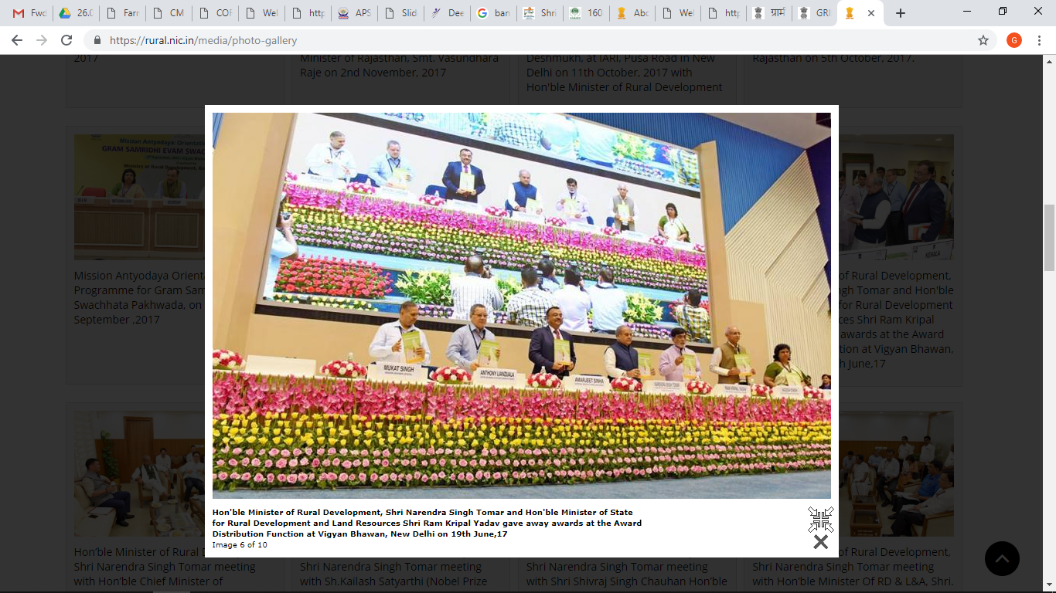
GRIP launched on 19th June 2017 by
Shri Narendra Singh Tomar, Hon’ble Minister of RD, PR & Mines

Slide 10
Government Process Re-engineering (GPR)
Removed Unnecessary Process Steps
Improved Work-flow
Just-In-Time para approval procedure
Easy Follow-up on ATR.

Slide 11
Technology used for GRIP
Built on Open Source Tools & Technology
Fully Secured Framework
Password-based Authentication
SHA256 Encryption for Password Protection
Interoperable
Data Exchange

Slide 12
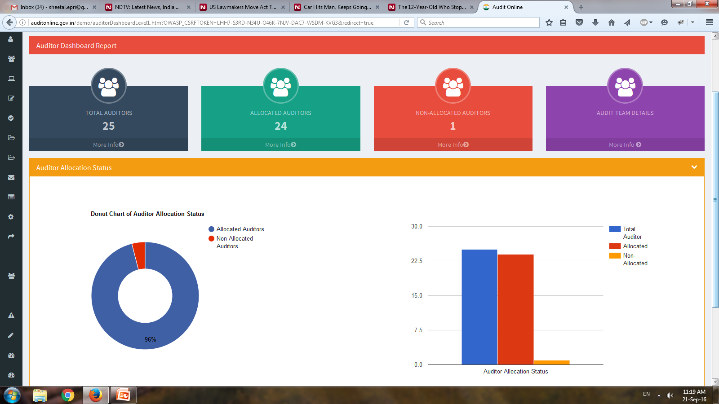
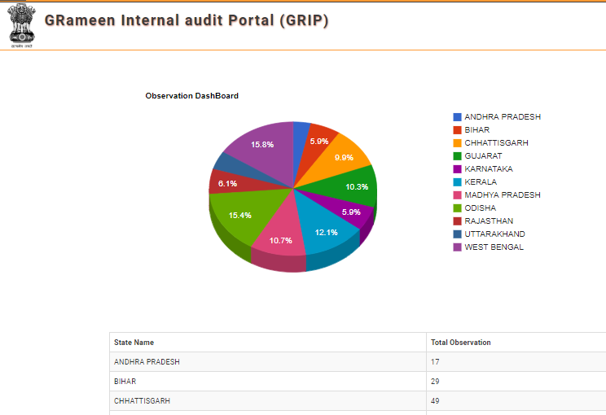
GRameen Internal Audit Portal-MIS
Interactive Dashboard for
Resource Management
Task Management
Risk Categories
State-wise Audit details
Observations Status-wise

Slide 13

GRIP Reduced Environmental Cost
Office printing has a huge environmental cost.
1 A4 sheet uses 0.5 LTRs. of water.
1 tree cuts down for 9000 A4 sheets.
CARTRIDGES causing pollution of water resources.
Manual process of conducting 55 Audits using ~2000 pages each in will amount to about 1,10,000 A4 sheets equaling to about 13 trees and 55000 LTRs. of water.

Slide 14
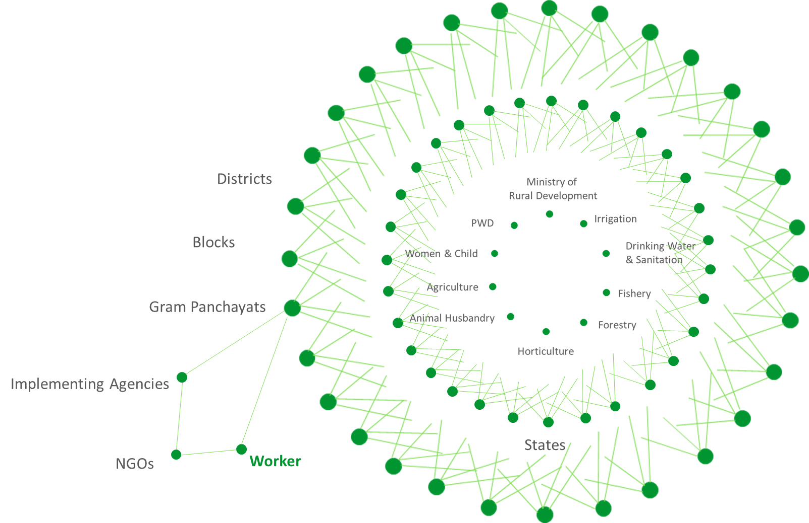
Blockchain in Internal Audit
The Ecosystem
A huge, complex, and partly-connected ecosystem of multiple stakeholders (multiple Ministries, States, Districts, Blocks, GPs, Implementing Agencies, NGO’s etc.) collaborate together to deliver benefits of Social Schemes (like MGNREGA) to Citizens and Workers.
* Example: Rs 400 Cr on Administrative Cost of Grievance Redressal in MGNREGA
Notes:
Data source:
http://mnregaweb4.nic.in/netnrega/citizen_html/citipoattend_rep.aspx
http://nrega.nic.in/netnrega/national_dashboard_detail.aspx

Slide 15
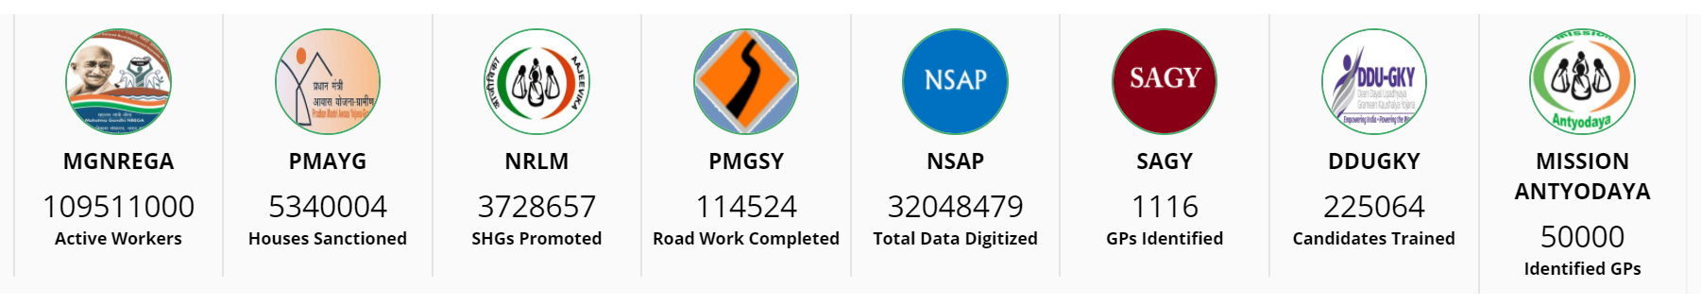
Background, and Opportunity
Within Ministry of Rural Development
Within Ministry, 8 large groups working on different schemes face some of the same challenges as outlined in last section.
Partly-connected groups working on systems which don’t talk to each other
Same beneficiary listed under various schemes of ministry without a consistent view of the beneficiary
Scenarios like: Program under scheme A, delivered by agency under scheme B, giving benefits to beneficiary under scheme C are quite common – current technologies don’t allow any visibility into wasteful spends
Notes:
Data source:
http://mnregaweb4.nic.in/netnrega/citizen_html/citipoattend_rep.aspx
http://nrega.nic.in/netnrega/national_dashboard_detail.aspx

Slide 16
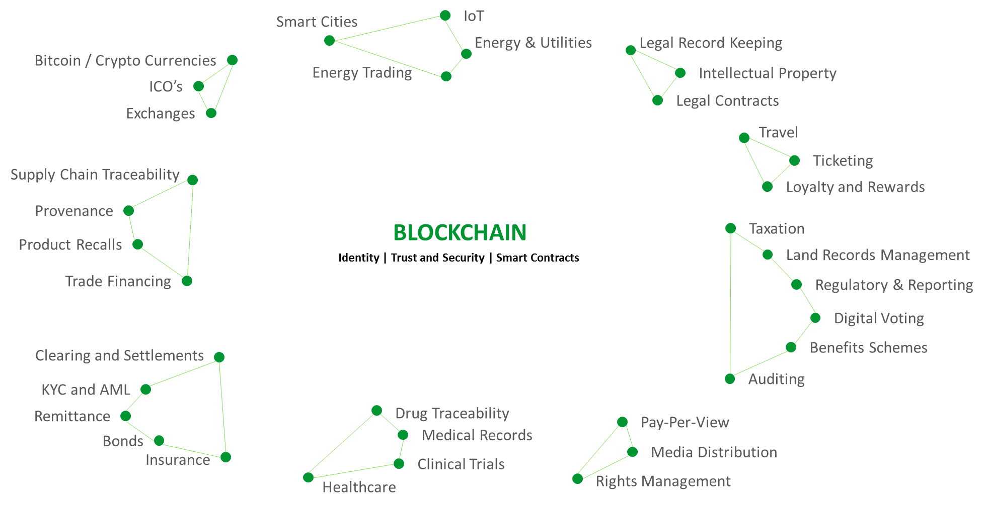
Potential Solution
Blockchain Technology offers a mechanism to resolve some of the challenges outlined above
Blockchain is a technology that facilitates trust between parties by providing a shared and verifiable history of transactions.
Blockchain accomplishes this by requiring participants to agree that a transaction is valid. It then uses multiple technologies to ensure that after the transaction is recorded it cannot be modified.
Worldwide BLOCKCHAIN Initiatives
Notes:
Data source:
http://mnregaweb4.nic.in/netnrega/citizen_html/citipoattend_rep.aspx
http://nrega.nic.in/netnrega/national_dashboard_detail.aspx

Slide 17
Blockchain - Pilot Project on GRIP
In light of above, a Blockchain Pilot Project has been conceptualised to demonstrate and derive the benefits of this technology and potential for various Government Schemes.
This project is being piloted taking Audit Process via GRIP (GRameen Internal Audit Portal) as a use case. The Pilot Project will be done without impacting the functioning of the existing GRIP Portal.
Audit Process represents some key traits peculiar to a Blockchain use case:
Multiple stakeholders
Different versions of truth within the ecosystem
Potential of discretionary data manipulation by one party etc.
Along with these, this process has minimal Risks associated with it with no actual money movement happening.
Notes:
Data source:
http://mnregaweb4.nic.in/netnrega/citizen_html/citipoattend_rep.aspx
http://nrega.nic.in/netnrega/national_dashboard_detail.aspx

Slide 18
GRIP - Pilot Project on Blockchain
Future Extensions:
Learnings from the project can create a more integrated GRIP Portal using Blockchain for creating a trusted-connected-ecosystem
This project will lay foundation for using Blockchain Benefits in other Government Schemes
The Project will also highlight avenues where portals like GRIP can be directly connected to query data from other sources, creating a more consistent and trusted solution
Subsequent sections provide more details on scope and solution for Phase 1 of this Piot Project
Notes:
Data source:
http://mnregaweb4.nic.in/netnrega/citizen_html/citipoattend_rep.aspx
http://nrega.nic.in/netnrega/national_dashboard_detail.aspx

Slide 19
Goals of Blockchain Pilot for GRIP Portal
Following are broad goals of this project:
Demonstrate potential of Blockchain Technology in various Government initiatives / schemes by taking use case of MGNREGA Audit Workflow (as described in GRIP presentation)
Identify opportunities where Blockchain could bring in efficiencies in existing process, while making the overall process more trusted and secure
Publish white paper on learnings from this first pilot project to create foundation for Blockchain use in subsequent initiatives

Slide 20


Scope & Solution Summary
Blockchain
Validating
Peer 1
Baseline data used to create initial User Identities on Blockchain
Orderer
CA
Validating
Peer 2
Environment on physical server
GRIP Portal
Filter relevant data which should be put on Blockchain
JOB
Transactions on Blockchain
Data
Push / Pull
Hash of documentary evidence on Blockchain
Documents
Push / Pull
Trusted Trail of Transaction Data
And
Documentary Evidences
OUTSIDE INTERACTION
PROJECT SCOPE

Slide 21
THANKS
Dr. Ajay S Singh, ICAS
Chief Controller of Accounts,
Ministry of Rural Development, Panchayati Raj and DWS
Email: a_singh@gov.in
Blog: www.ajaytejpura.blogspot.in

